Slide 1
A Practical view on teaching english
Jacob Gaston

Slide 2
agenda
Introduction and getting started
Warm up your english language
Scaffolding language in writing
Feedback on an authentic student production
In groups: Prepare a teachingplan
Present your lessonplan
Reflections from today

Slide 3
Teaching goals
1. I can create a teaching plan by using the didactical model: The Teaching Learning Cycle
2. I can scaffold language by having a focus on keywords and chunks
3. I can give feedback on an authentic student production

Slide 4

From the students point of view
Points of reflection throughout the day:
Which parts of the activities forces the students to speak english?
How is the student’s language scaffolded?
How did the students work on their intercultural competence?
Which activities do you want to include in your future teaching?

Slide 5
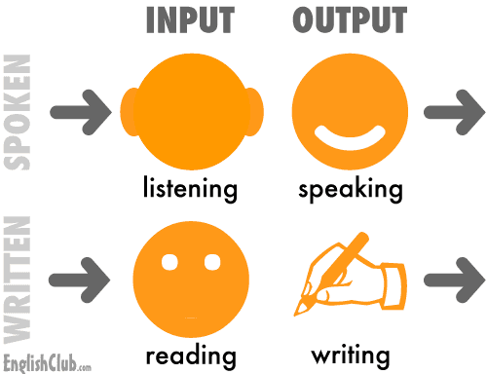
Aim:
To use each every lesson

Slide 6
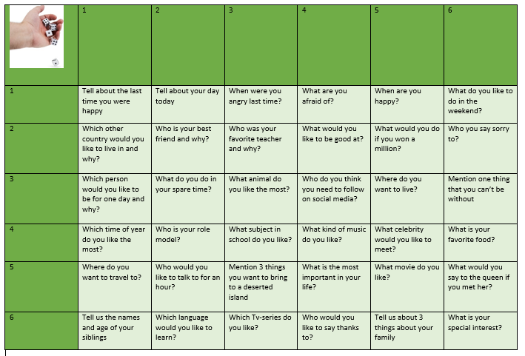
Getting to know you
Speak
Listen
Read

Slide 7
An authentic lesson in 8.D

Slide 8

Warm up 1: Lego
Giving instructions
How did this activity practice the students communicative competence?
Any specific wordclasses that are being used to give instructions??
How does the activity force the students to speak english?

Slide 9
Scaffolding language in writing

Slide 10
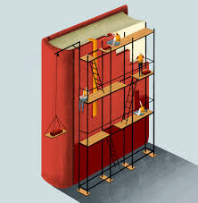
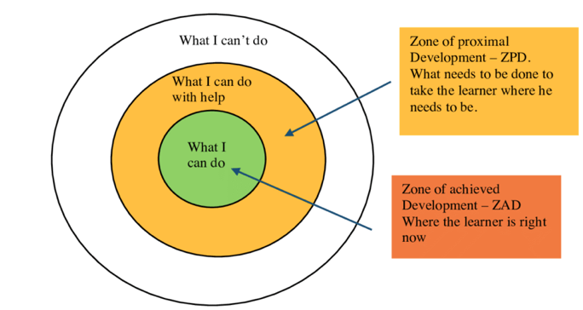
Scaffolding language in writing…
We want to support the learner in their learningprocess.
We want them to learn to use language that they can’t do yet and to learn how to write a type of text that they can’t do yet!

Slide 11
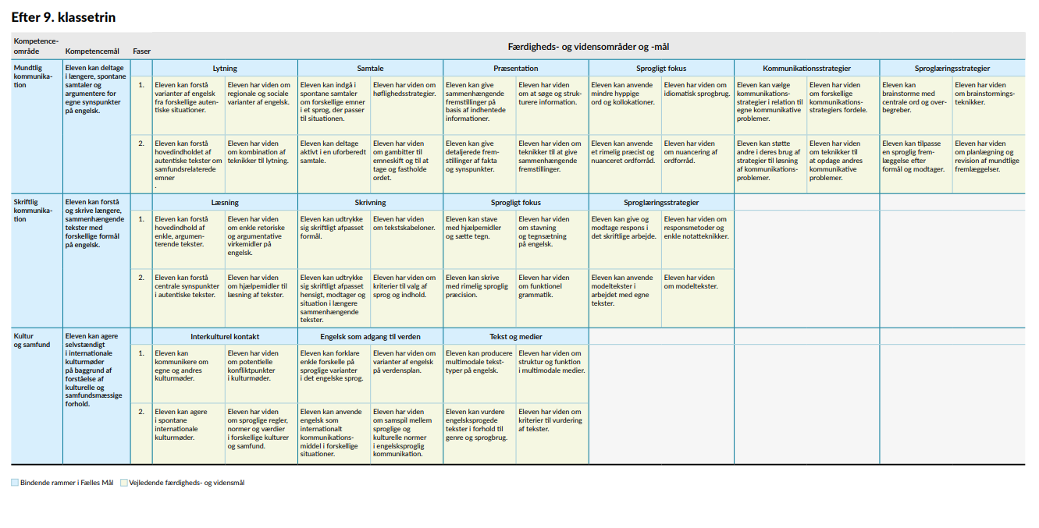

Slide 12

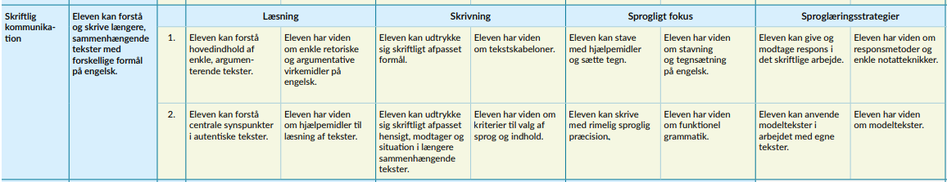
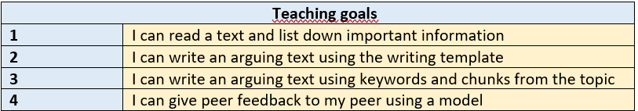
The commongoals into teaching goals
Source: Common goals https://emu.dk/sites/default/files/2020-09/GSK_F%C3%A6llesM%C3%A5l_Engelsk.pdf

Slide 13
Pre knowledge
The class were going to write a text about their opinion on Apartheid in South Africa.
The class had been working with the topic for a few weeks.
They had been reading authentic and non-authentic materiale, watching films, and seen youtube-clips.
All of the sources was used to collect knowledge and vocabulary/keywords.
Keywords:
Apartheid
Segregation
Colored people
Townships
Poor
Discrimination
Non-violence
And many more….

Slide 14
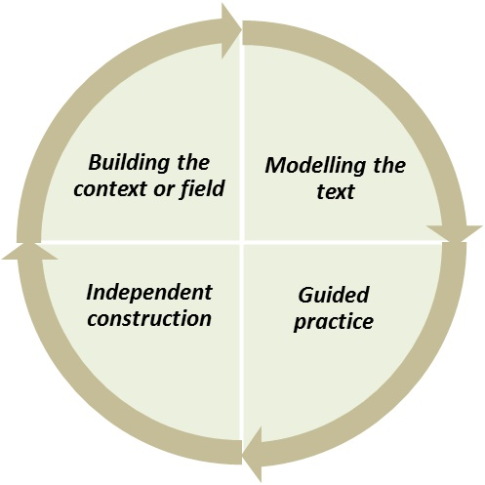
Teaching learning cycle
v
Input → output

Slide 15
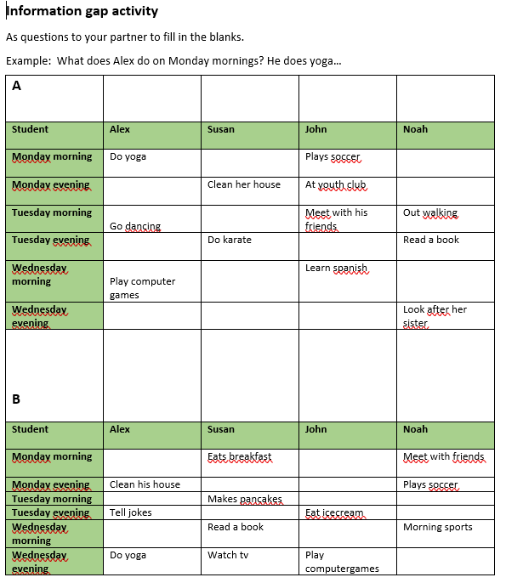

Information gap activity
How did this activity practice the students communicative competence?
How does the activity force the students to speak english?

Slide 16
A tour of the teaching learning cycle from students perspective

Slide 17
1. Building the context or field
Working with words
Quiz and trade
Building knowledge of Apartheid in South Africa: Watch the youtube clip
Work with questions
Present to a group
Scaffolding your opinion

Slide 18
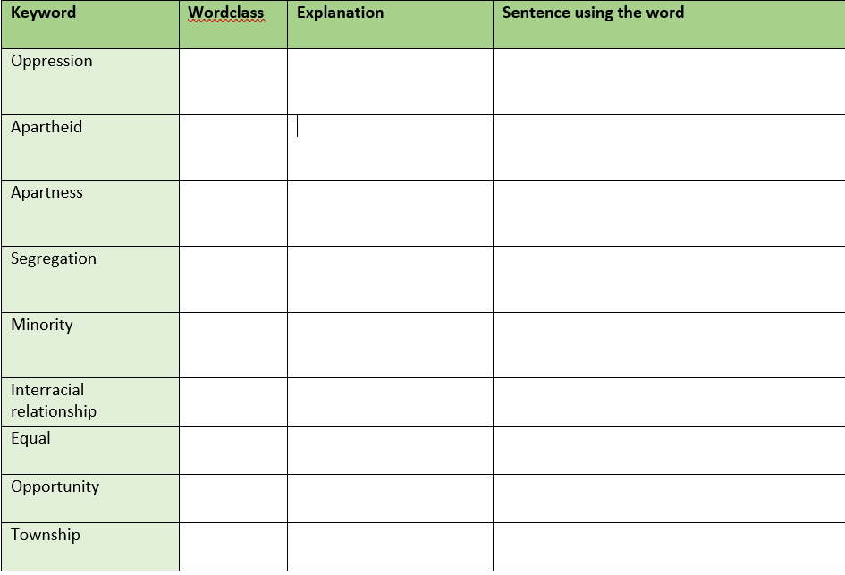
Working with words
Refrasing = communicating
Points of reflection:
How does this scaffold the student’s language?
What was your impression of explaining rather than translating?

Slide 19

Quiz-quiz-trade
Points of reflection:
Which communicative compentencies does this practice?

Slide 20


Slide 21
Questions for the clip
When was the first election in South Africa?
What is apartheid with your own words?
How was life for the black people?
Give examples of how the races were segregated…
Could non-whites vote?
How did they test if you were european enough?
How did the black people protest against this system?
How did apartheid come to an end?
In groups of 3
Reflect – write

Slide 22
WRITE
REFLECT

Slide 23
Points of reflection:
Why do you think I want to be in control when the groups has to reflect and write?
Does this didactical tool create a context where you have to use your communicative competences?

Slide 24
Present your answers in inner-outer circle
1
8
8
2
7
1
2
3
7
6
3
5
4
6
4
5

Slide 25
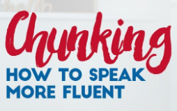

Slide 26
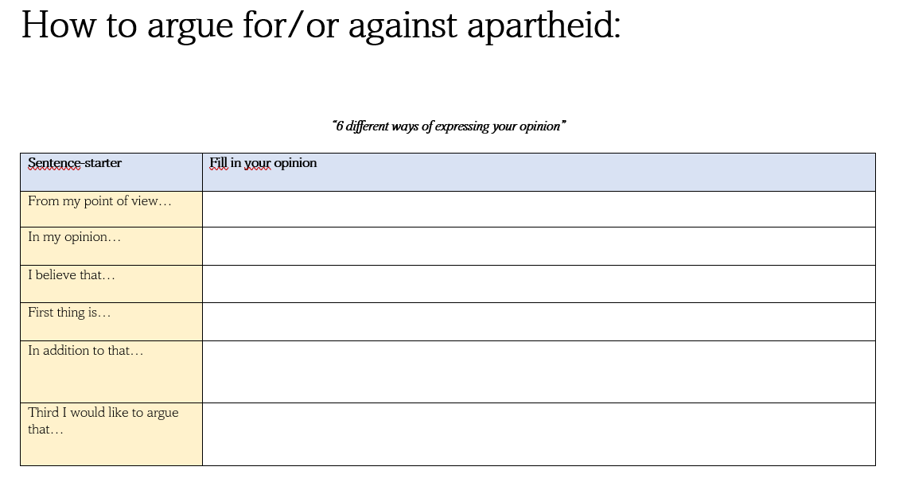
Scaffolding: Your opinion

Slide 27

I play…

Slide 28
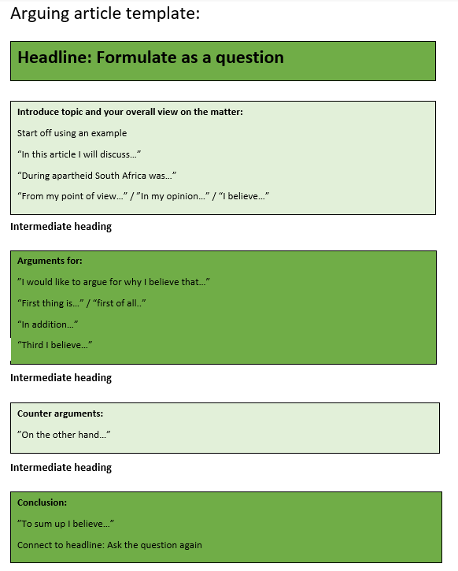
Modelling the text
Read an example
Deconstruct the example

Slide 29

Example of an arguing text
Deconstruct the text:
Use the template. Find the sentencestarters and mark them with yellow
Does the text create coherence between the headline and the end?
What opinion does the article express?
Create an alternative headline

Slide 30
Guided practise
Watch youtube: Det er jo forår
Point of discussion: Is it ok to shop not wearing clothes
Pros / cons list
Overall opinion in class
Joint construction using template
Output: Model construction
Create a text from template together in class

Slide 31
Det er forår!
https://www.youtube.com/shorts/NTpEa8oi9Yk
Point of discussion: Is is ok to wear almost nothing when shopping?
Create pros/cons list
The overall opinion in class is….??
Pros | Cons

Slide 32
Joint construction
Together with the class the teacher uses the template to create an arguing article on whether it is ok to go out shopping wearing almost nothing.
Encourage the learner to use the sentencestarters/chunks
Group preparation:
Devide chunks in groups and give time to prepare their part of the joint construction
From my point of view
In my opinion
I believe that
First thing is…
Third I would like to argue that
In addition to that<

Slide 33
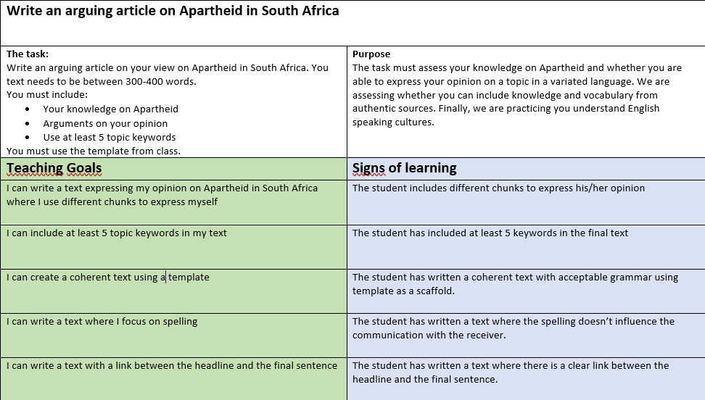
Independent construction
Write first draft using the template
Peer feedback
Second draft
Hand in teacher
Feedback from teacher

Slide 34
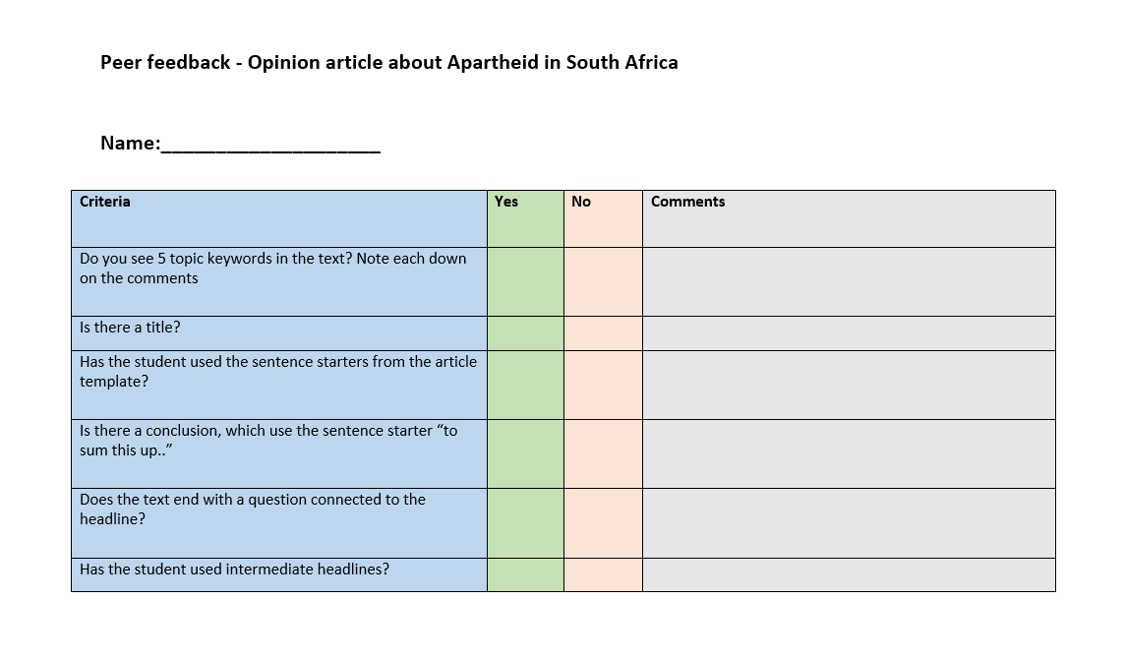
Peer feedback

Slide 35
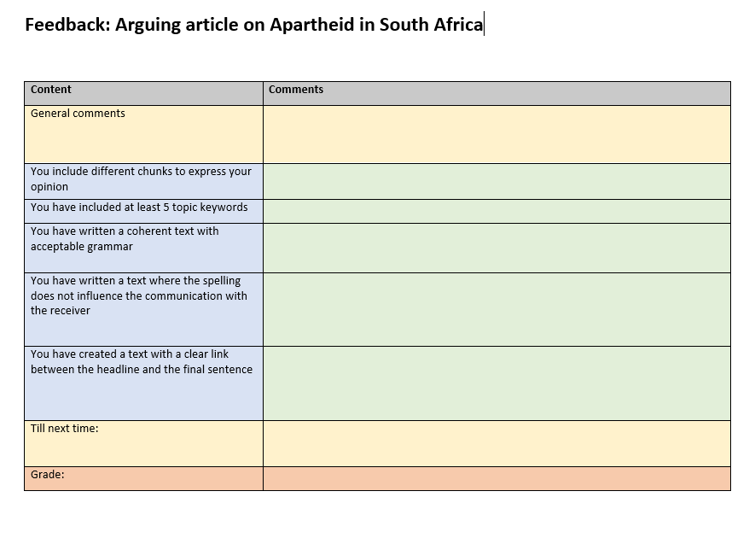

Slide 36
Warm up – tell about….

Slide 37


Give your feedback

Slide 38
Present your feedback
Team A presents to team B

Slide 39

Task Based Learning
How did this activity practice the students communicative competence?
How does the activity force the students to speak english?
How is this activity pushing the students vocabulary?

Slide 40
Now it’s your turn!
Create a teaching plan.
Mainfocus: Scaffold the student’s language in writing
Proces:
Choose 4 commongoals
Decide on a type of text (fairytail, shortstory, newsarticle, speech, letter etc.)
Formulate teaching goals
Plan your teaching plan (Use Teaching Learning Cycle)
Include: Peerfeedback in stage 4 + teacher feedback criteria
Include chunks

Slide 41
Chunks
From my point of view
It’s obvious that…
As a matter of fact…
As I see it…
I am convinced that…
Meanwhile…
With that said…
When it comes to…
”As for example…
”We may ask…
”Last but not least…
”To start off I want to define…

Slide 42
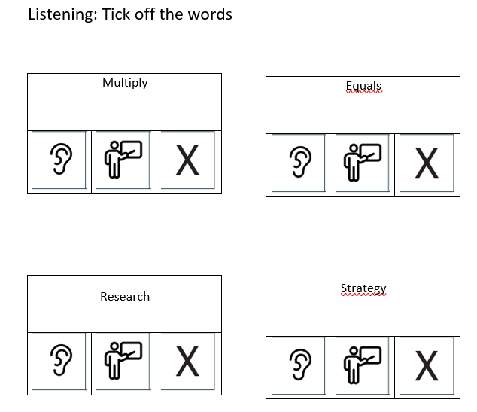



Listening bingo
To give all students a role during presentations and use as peerfeedback
Do I hear the word?
Is the word explained?
Is the word used?

Slide 43
Reflections from today
Which parts of the activities forces the students to speak english?
How is the student’s language scaffolded?
How did the students work on their intercultural competence?
Which activities do you want to include in your future teaching?

